Slide 1
Scalable Multi-Node AI Workloads using SDN K8s Networking
Girish Moodalbail, NVIDIA
Leonid Grossman, NVIDIA

Slide 2
Introduction
Who we are
NVIDIA SDN team
Building and operating accelerated SDN for NVIDIA Clouds
Leveraging COTS hardware and OSS software
To deliver a combination of networking performance and security
At reasonable cost
K8s compute, OVS/OVN Networking
Whom this talk is for
Multi-node Multi-tenant AI Cloud Infrastructure - “Make” vs. “Buy”
If you are interested in building it with OSS - this talk is for you

Slide 3
Accelerated Compute and Accelerated Networking for AI
The slowdown of Moore's Law
2x compute every 2 years from 1975 till recently, but expected to be dead in a few years
The rise of Accelerated Compute to meet computational demands of AI
1000x increase of compute capacity over 8 years delivered
8000 H100 to train GPT4, likely almost 10x to train GPT5 (rough estimates)
The short history of Accelerated Networking
“Fast Network, Slow Host” cycles happened before - but now it’s here to stay
Proprietary fabrics vs. Ethernet
NIC offloads - stateless accelerations, kernel bypass (SR-IOV and RDMA) and more
Networking accelerations and OSS networking projects almost always succeed together
Accelerated Open Virtual Switch and Overlays, for a combination of performance and security

Slide 4
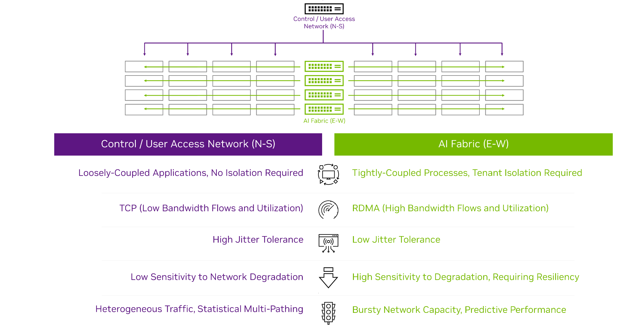
AI Compute workloads require AI fabric
Notes:
AI workloads introduce some new challenges that need to be addressed by AI clouds. AI training workloads consist of iterations of interdependent, tightly-coupled processes and require high bandwidth and low jitter. Typical TCP is not sufficient; RDMA is needed for acceleration. In addition, satisfying the “average workload” is not sufficient; AI workloads are very bursty and require a network that delivers the necessary performance in both the average and worst case.

Slide 5
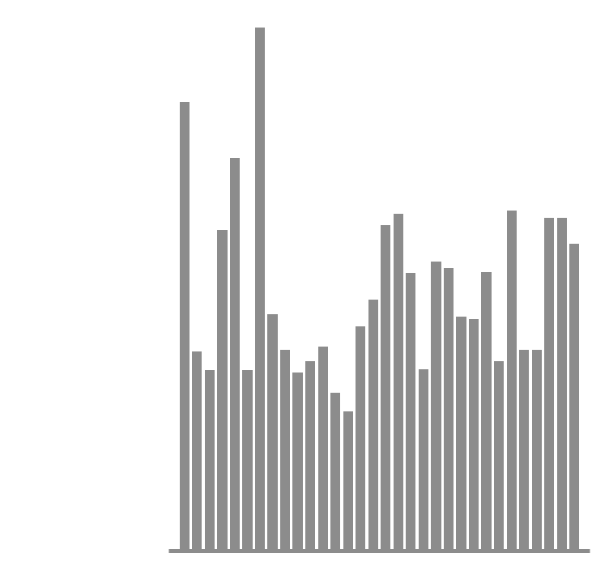

Ethernet Fabric (NICs/Switches) improvements for AI
End-to-end Adaptive RDMA routing
Switch spreads the packets across routes
NIC ensures packet order
Bandwidth increase from 60% to 95%
Programmable Congestion Control
Detects congestion and meters flows
No noise from diverse workloads
Also - https://ultraethernet.org/
Traditional Ethernet vs. Ethernet Fabric
Accelerated Networking for multi-node AI with OSS is possible today
More details are/coming at https://ovn-kubernetes.io/
Notes:
The 2 key innovations in Spectrum-X are:
Per packet load balancing instead of per flow load balancing – for ROCE traffic. This avoids the ECMP load balancing issues with elephant flows and allows for a leaf spine network to achieve 95% utilization instead of 60%
Programmable congestion control for many-to-one or incast traffic patterns. Spectrum-x detects & reacts to congestion much faster than ROCEv2.

Slide 6
DL Training and Inter-GPU Communication

Slide 7
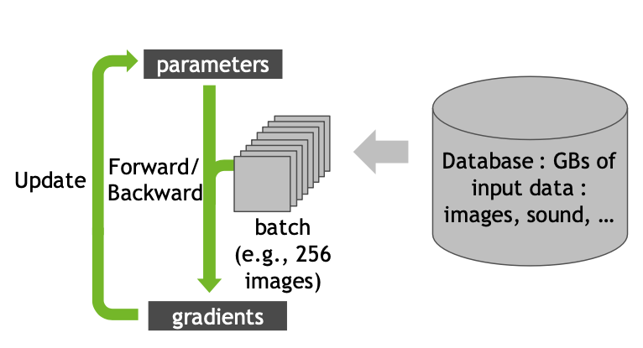
Single GPU Training

Slide 8
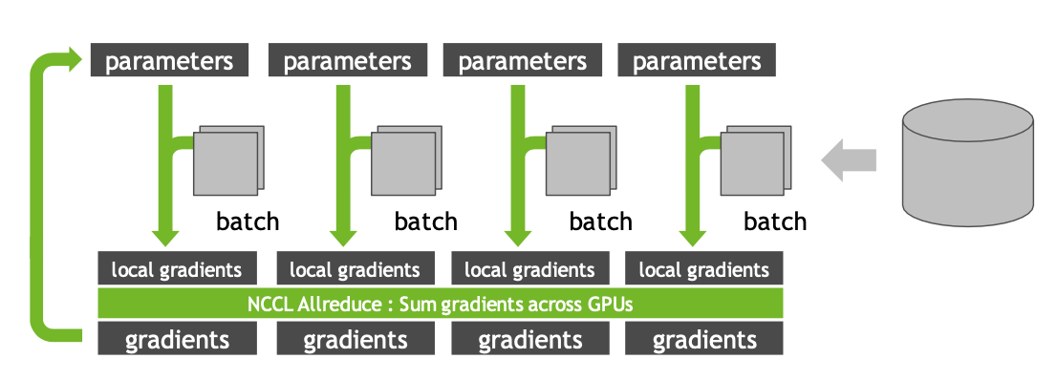
Multi-GPU Training
Data Parallelism

Slide 9
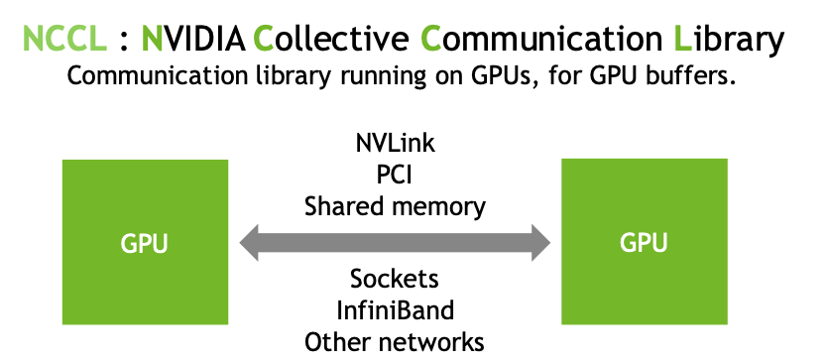
Optimized Inter-GPU Communication
Frameworks (Tensorflow/Horovod, PyTorch, ….)
NCCL
CUDA
NVIDIA GPUs
NCCL is topology-aware and is optimized to achieve high bandwidth and low latency over PCIe, NVLINK, Ethernet and IB internetwork. Source code : https://github.com/nvidia/nccl Perf tests : https://github.com/nvidia/nccl-tests

Slide 10
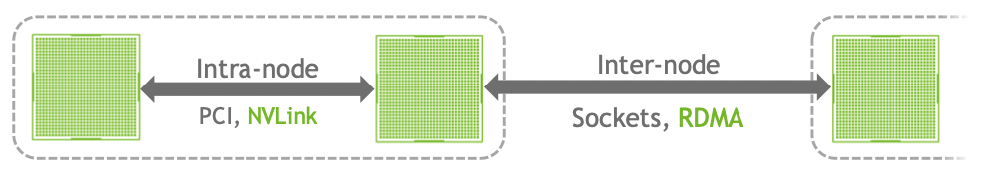
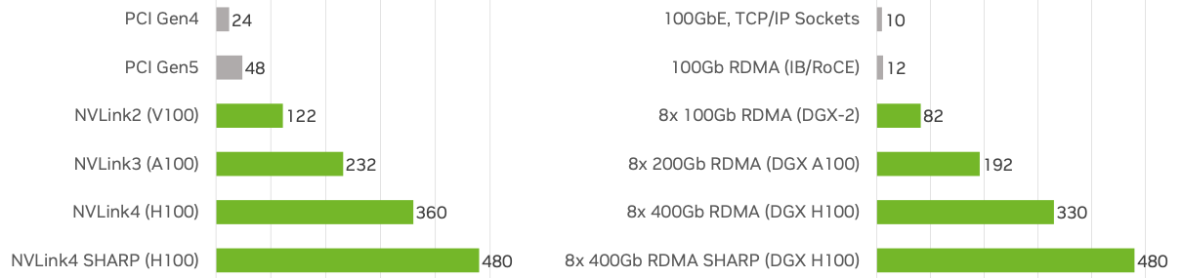
Inter-GPU Communication
Intra-node and Inter-node
Effective bandwidth in GB/s

Slide 11
OSS SDN Networking Stack

Slide 12
SDN K8s Pod Networking
…… provide a secure, isolated, predictable, consistent, and uncompromising level of performance networking to the K8s AI workload Pods together with high performance network fabric – tightly coupled network adapter and switch …...
Achieved using
core OSS Components that forms SDN K8s Pod Networking
Open vSwitch (OVS) - https://www.openvswitch.org
Open Virtual Network (OVN) - https://www.ovn.org
Open Virtual Network Kubernetes CNI (OVN-K8s CNI) - https://ovn-kubernetes.io/
and network adapters from various vendors with
Programmable SR-IOV VFs that offloads ACLs, Forwarding, NATing, DSCP marking
Offloaded RoCE to satisfy large data movement between GPUs
Performance Isolation with End-To-End QoS to ensure in a multi-tenant and multi-job environment, one job does not impact the other.
Notes:
Build and buy..
This is how we are going

Slide 13
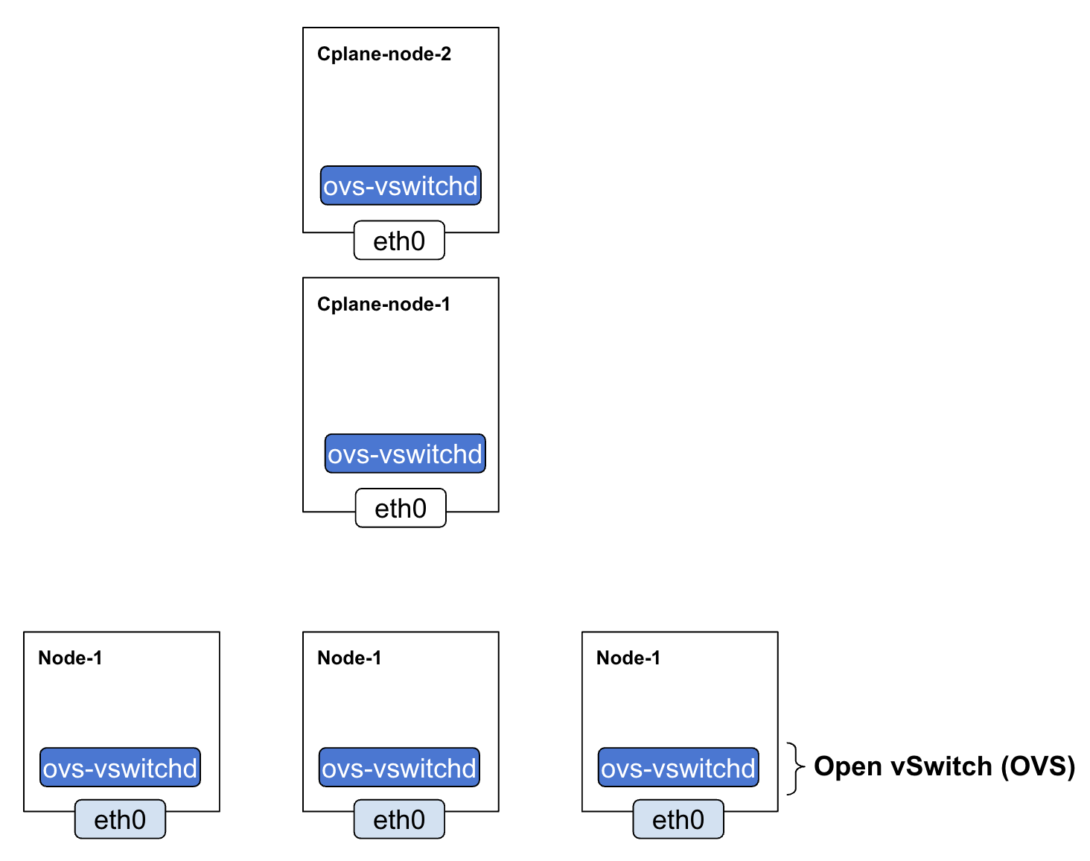
OVS on Every Node
Notes:
Build

Slide 14
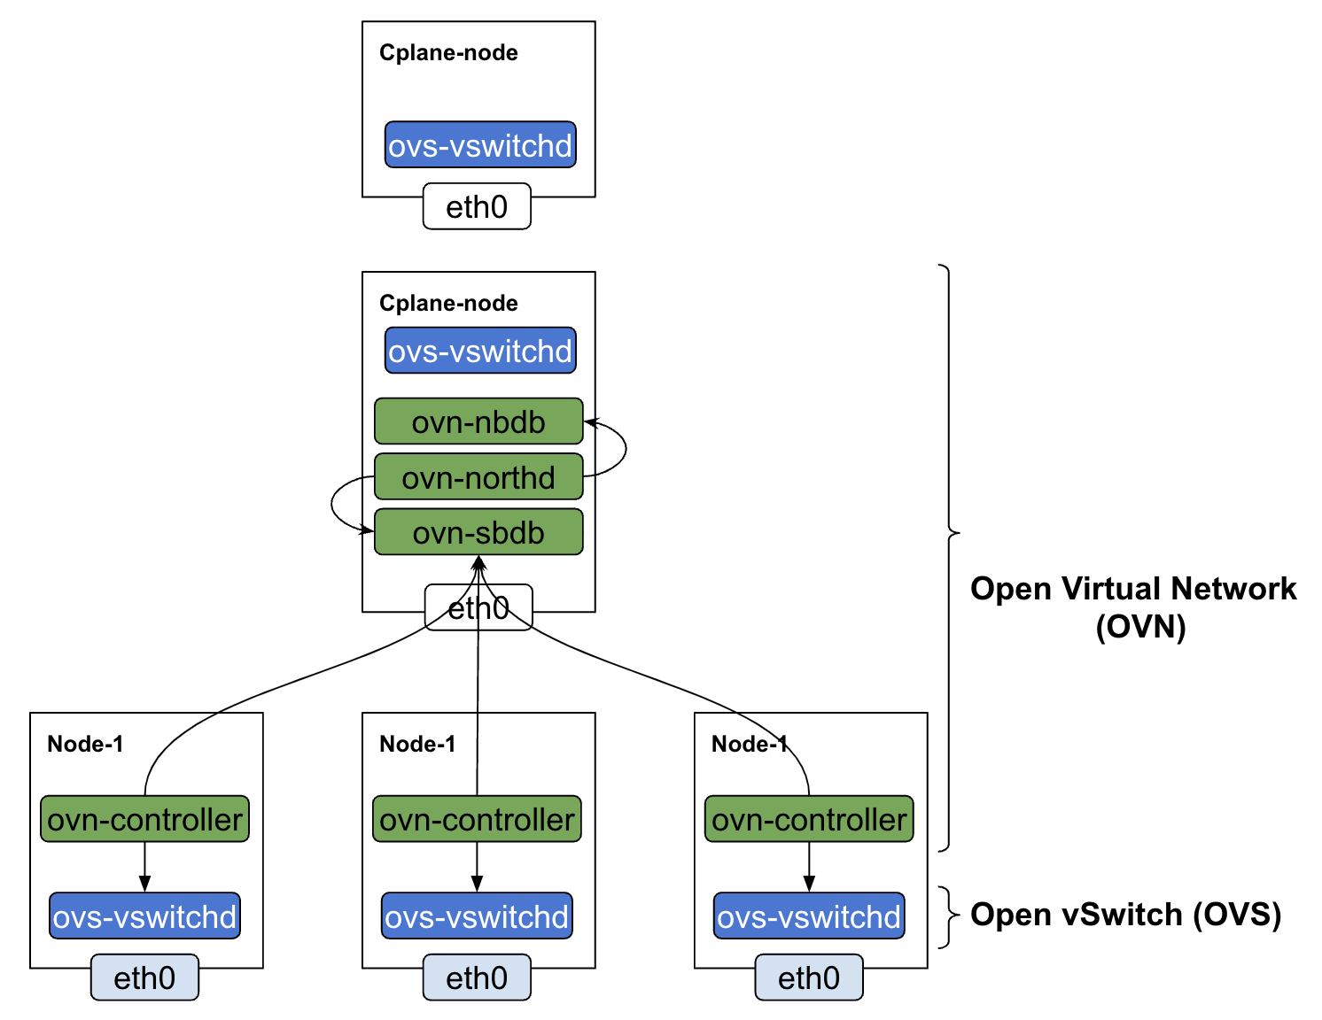
OVN on Every Node and a Central Component

Slide 15
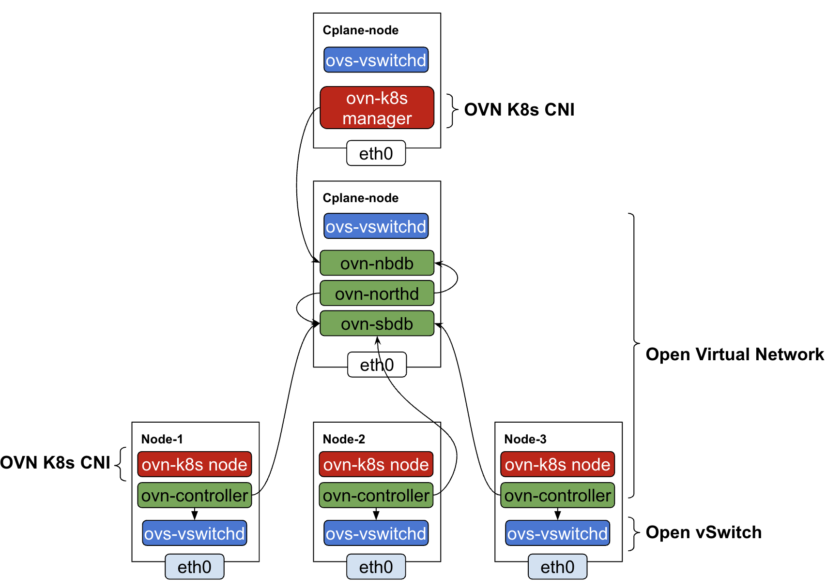
OVN-K8s on Every Node and a Central Component

Slide 16
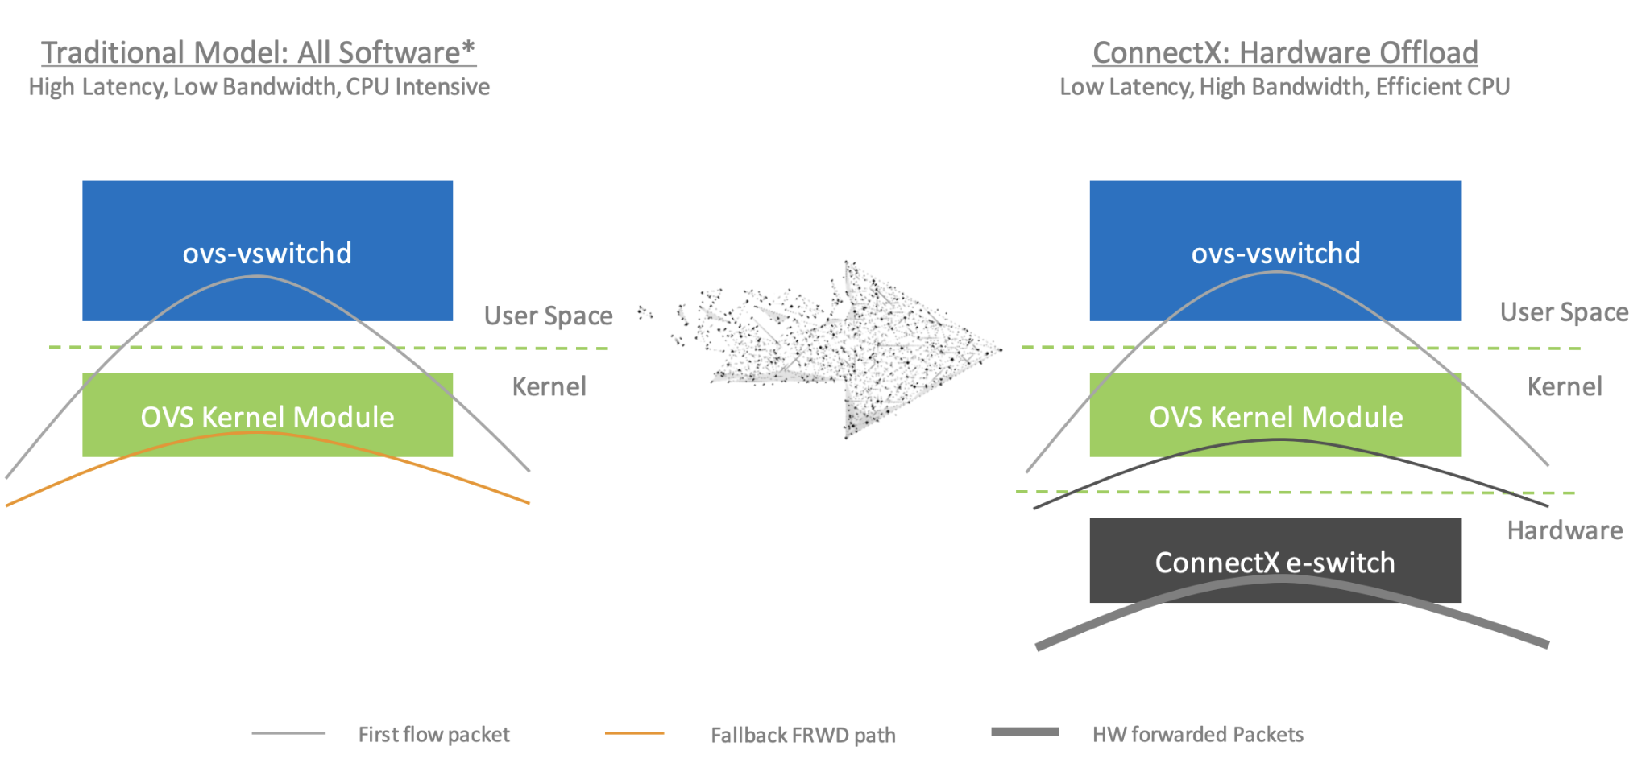
Acceleration of OVS Datapath

Slide 17
OVN-K8s CNI
OVN K8s is a K8s Network plugin that implements the Container Networking Interface Specification that Kubelet understands
Open Source Project
https://github.com/ovn-kubernetes/ovn-kubernetes
Got inducted into CNCF as a Sandbox Project (https://github.com/cncf/sandbox/issues/302)
Moved out of ovn-org organization to its own github project
Is built on top of OVN/OVS
Defines a OVN Logical Topology to interconnect K8s Pods
Maps K8s API Resources to OVN Logical Constructs

Slide 18
K8s Resource/Features to OVN Resource Mapping
K8s Resource/Features | OVN Resource
NetworkPolicy | OVN ACLs, PortGroups, AddressSet
Service (East-West/North-South) | OVN LoadBalancer
Pod | OVN LogicalSwitchPort
Pod connectivity East-West Traffic | OVN LogicalSwitch/ OVN LogicalDistributedRouter
Pod connectivity North-South Traffic | OVN LogicalSwitch/ OVN LogicalDistributedRouter/ OVN LogicalRouterStaticRoute/ OVN LogcalGatewayRouter/ OVN NAT
AdminNetworkPolicy | OVN LogicalRouterPolicy
NetworkQos | OVN Qos/Meters
PacketMirroring | OVN Mirrors

Slide 19
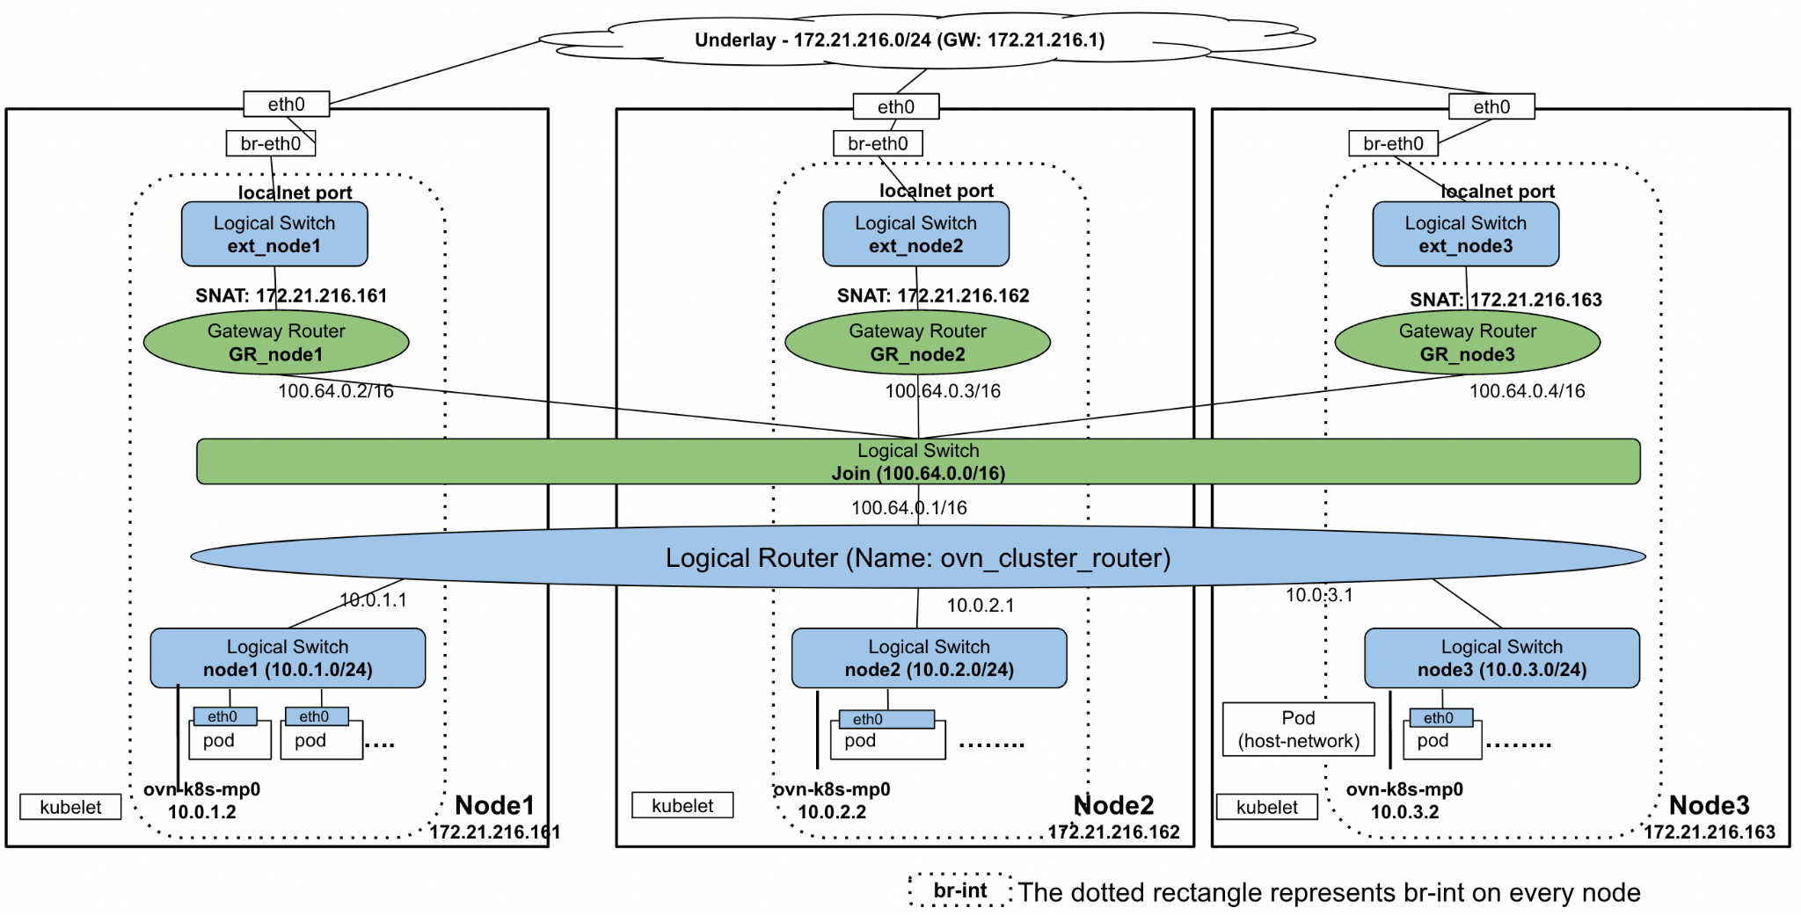
OVN K8s Logical Topology for Single Interface Pod

Slide 20
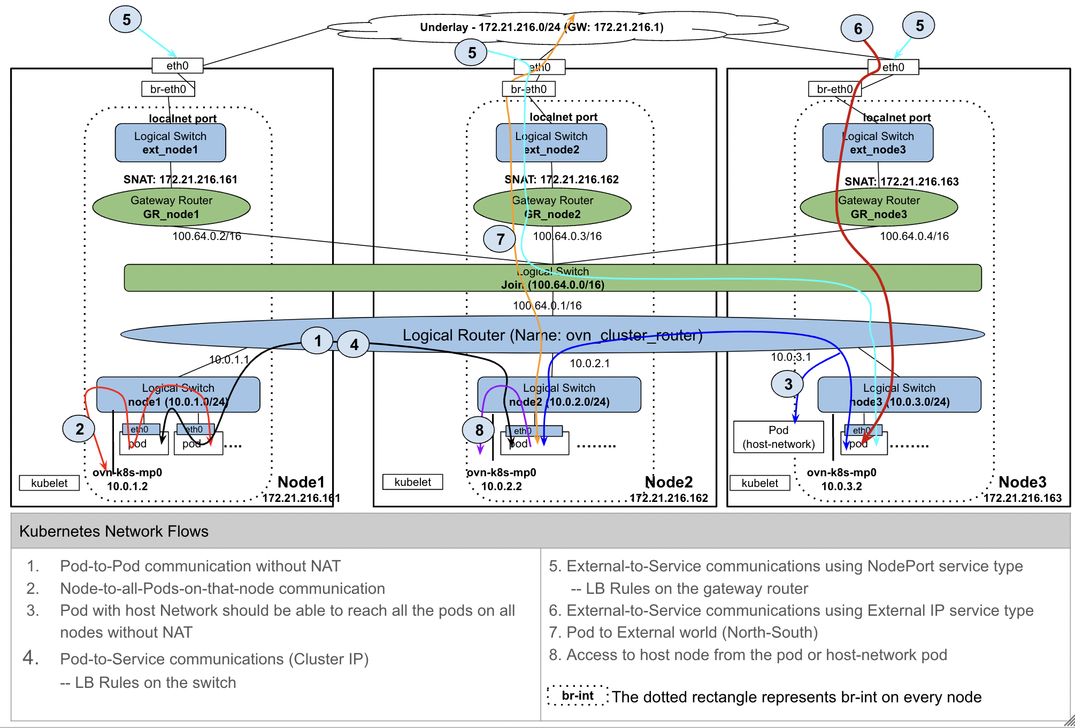
K8s Network Flows on OVN Logical Topology

Slide 21
DC Physical and Logical Networking

Slide 22
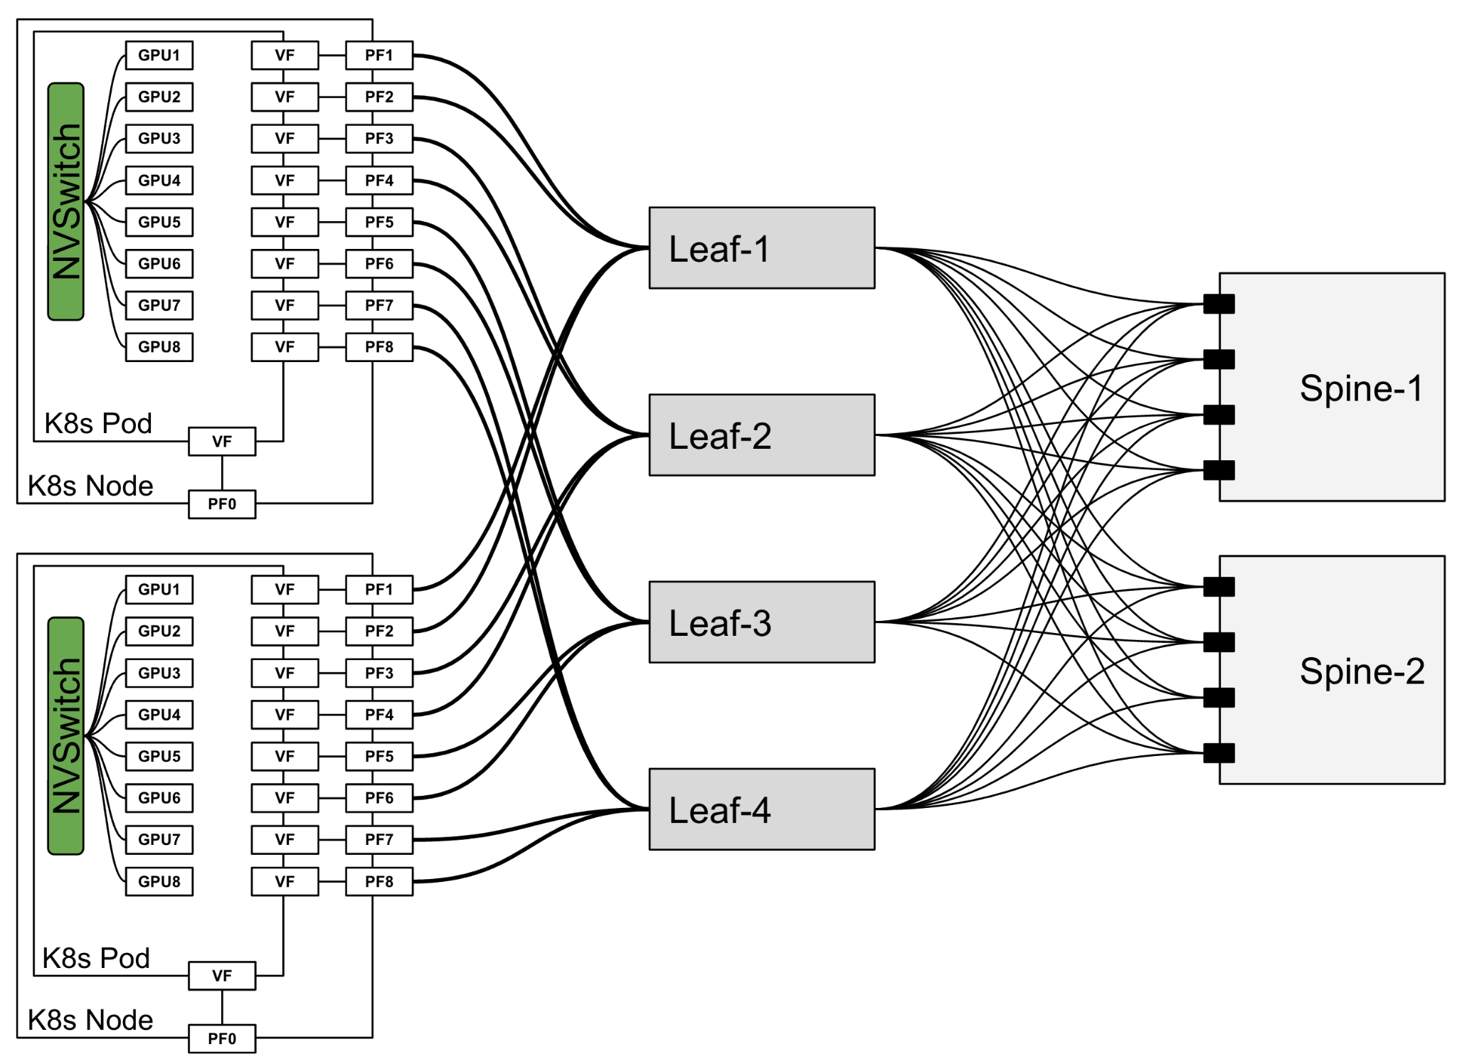
Rail Optimized DC Architecture
All NICs with the same index are connected to the same switch. Therefore, there will be no traffic to the spine when
GPUs at the same index across nodes communicate
GPUs at different index across nodes communicate by first traversing the local NVSwitch to the GPU on same Index as target GPU and then using the corresponding NIC
Routing collisions are impossible and therefore better utilization of switch ports.
Spines are involved when the traffic is moving across a pod of nodes

Slide 23
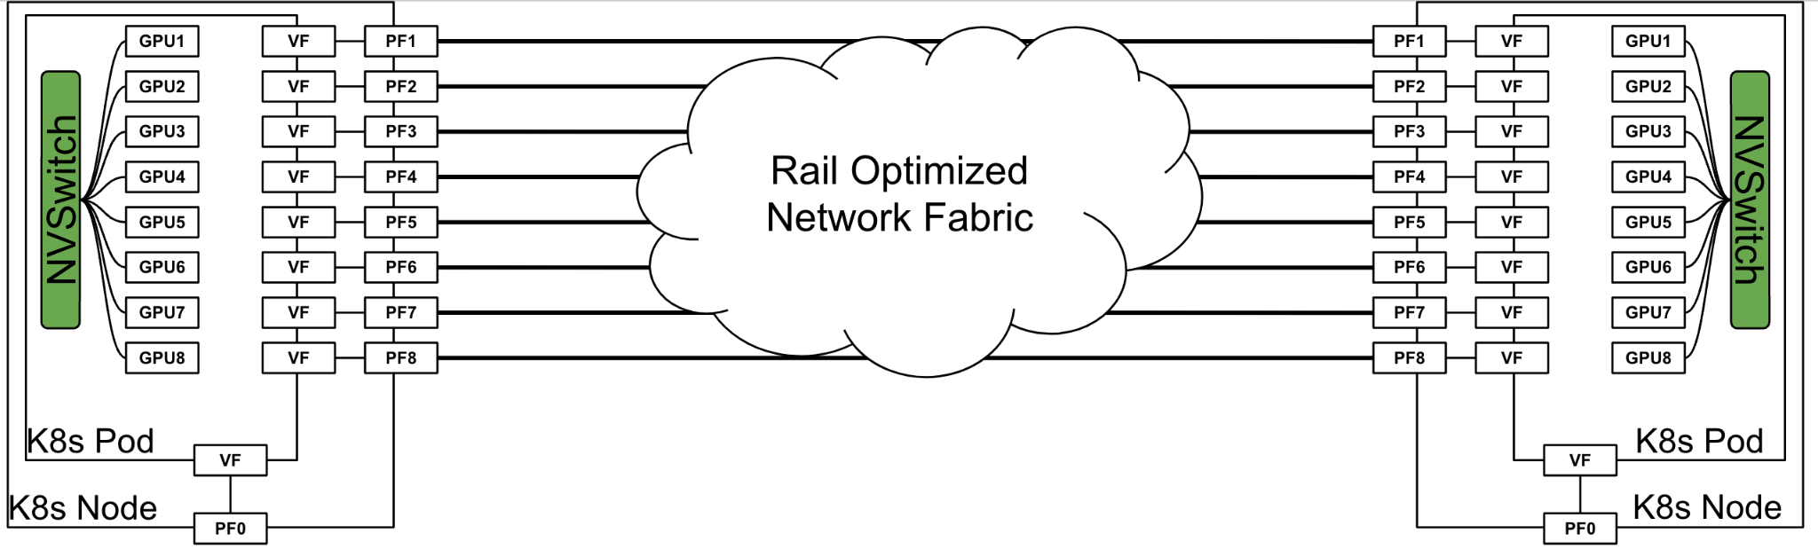
Rail Optimized DC Architecture - Concise View

Slide 24
AI Workload Networking - Multus/Primary CNI/SR-IOV CNI
AI Workload Pods need to be multi-homed
Multus is leveraged to plumb multiple interfaces to the Pod
The traffic through primary interface of the Pod is low
primarily used for NCCL control plane and K8s Control plane
The traffic through secondary networks are high
The PFs NICs are passed through into the running Pod and underlay IPs are plumbed on these PFs
We lose ability to apply K8s Network Policies and Network QoS on these interfaces
Becomes very hard to enable Multi-Job, Multi-Tenancy AI Cloud

Slide 25
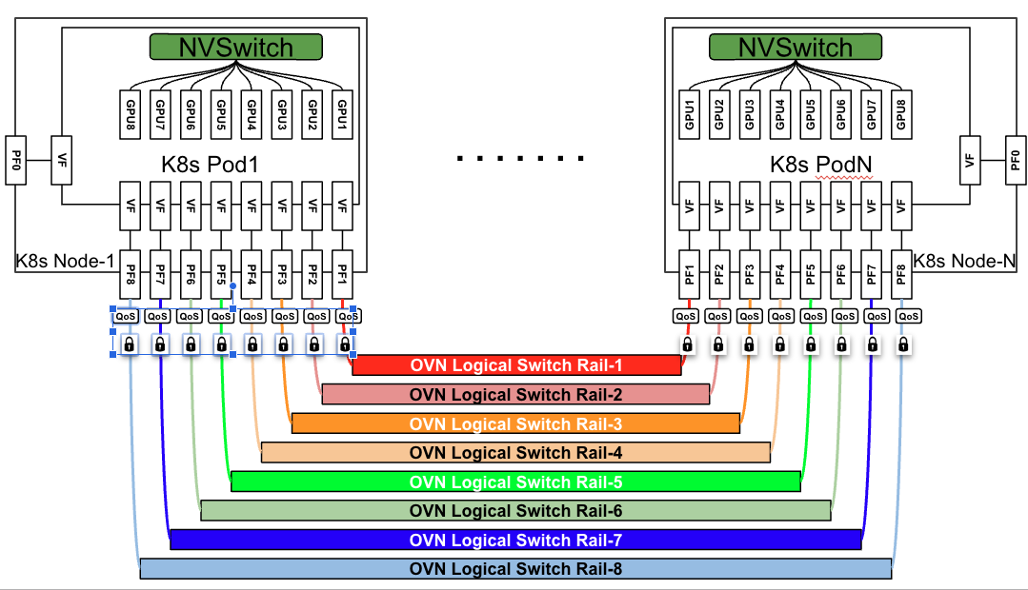
Rail Optimized DC Architecture - OVN Logical View

Slide 26
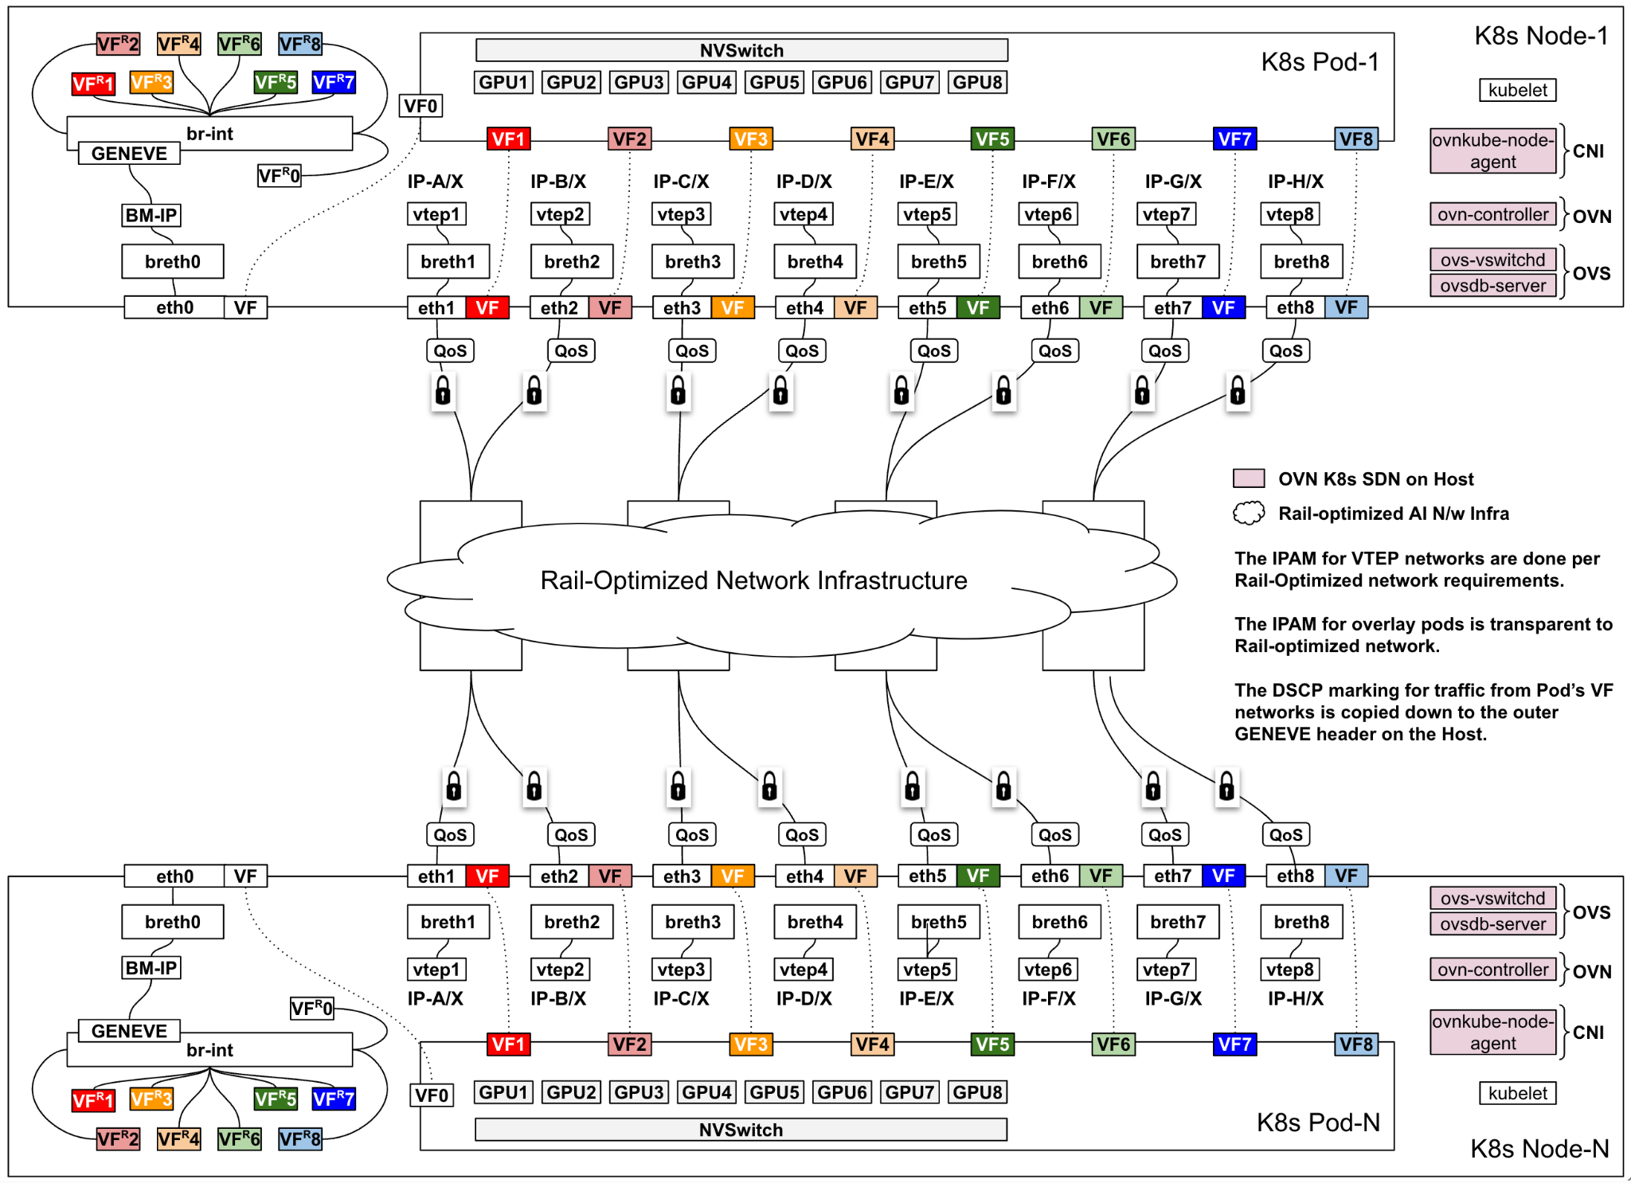
Rail Optimized DC Architecture - SDN Physical View

Slide 27
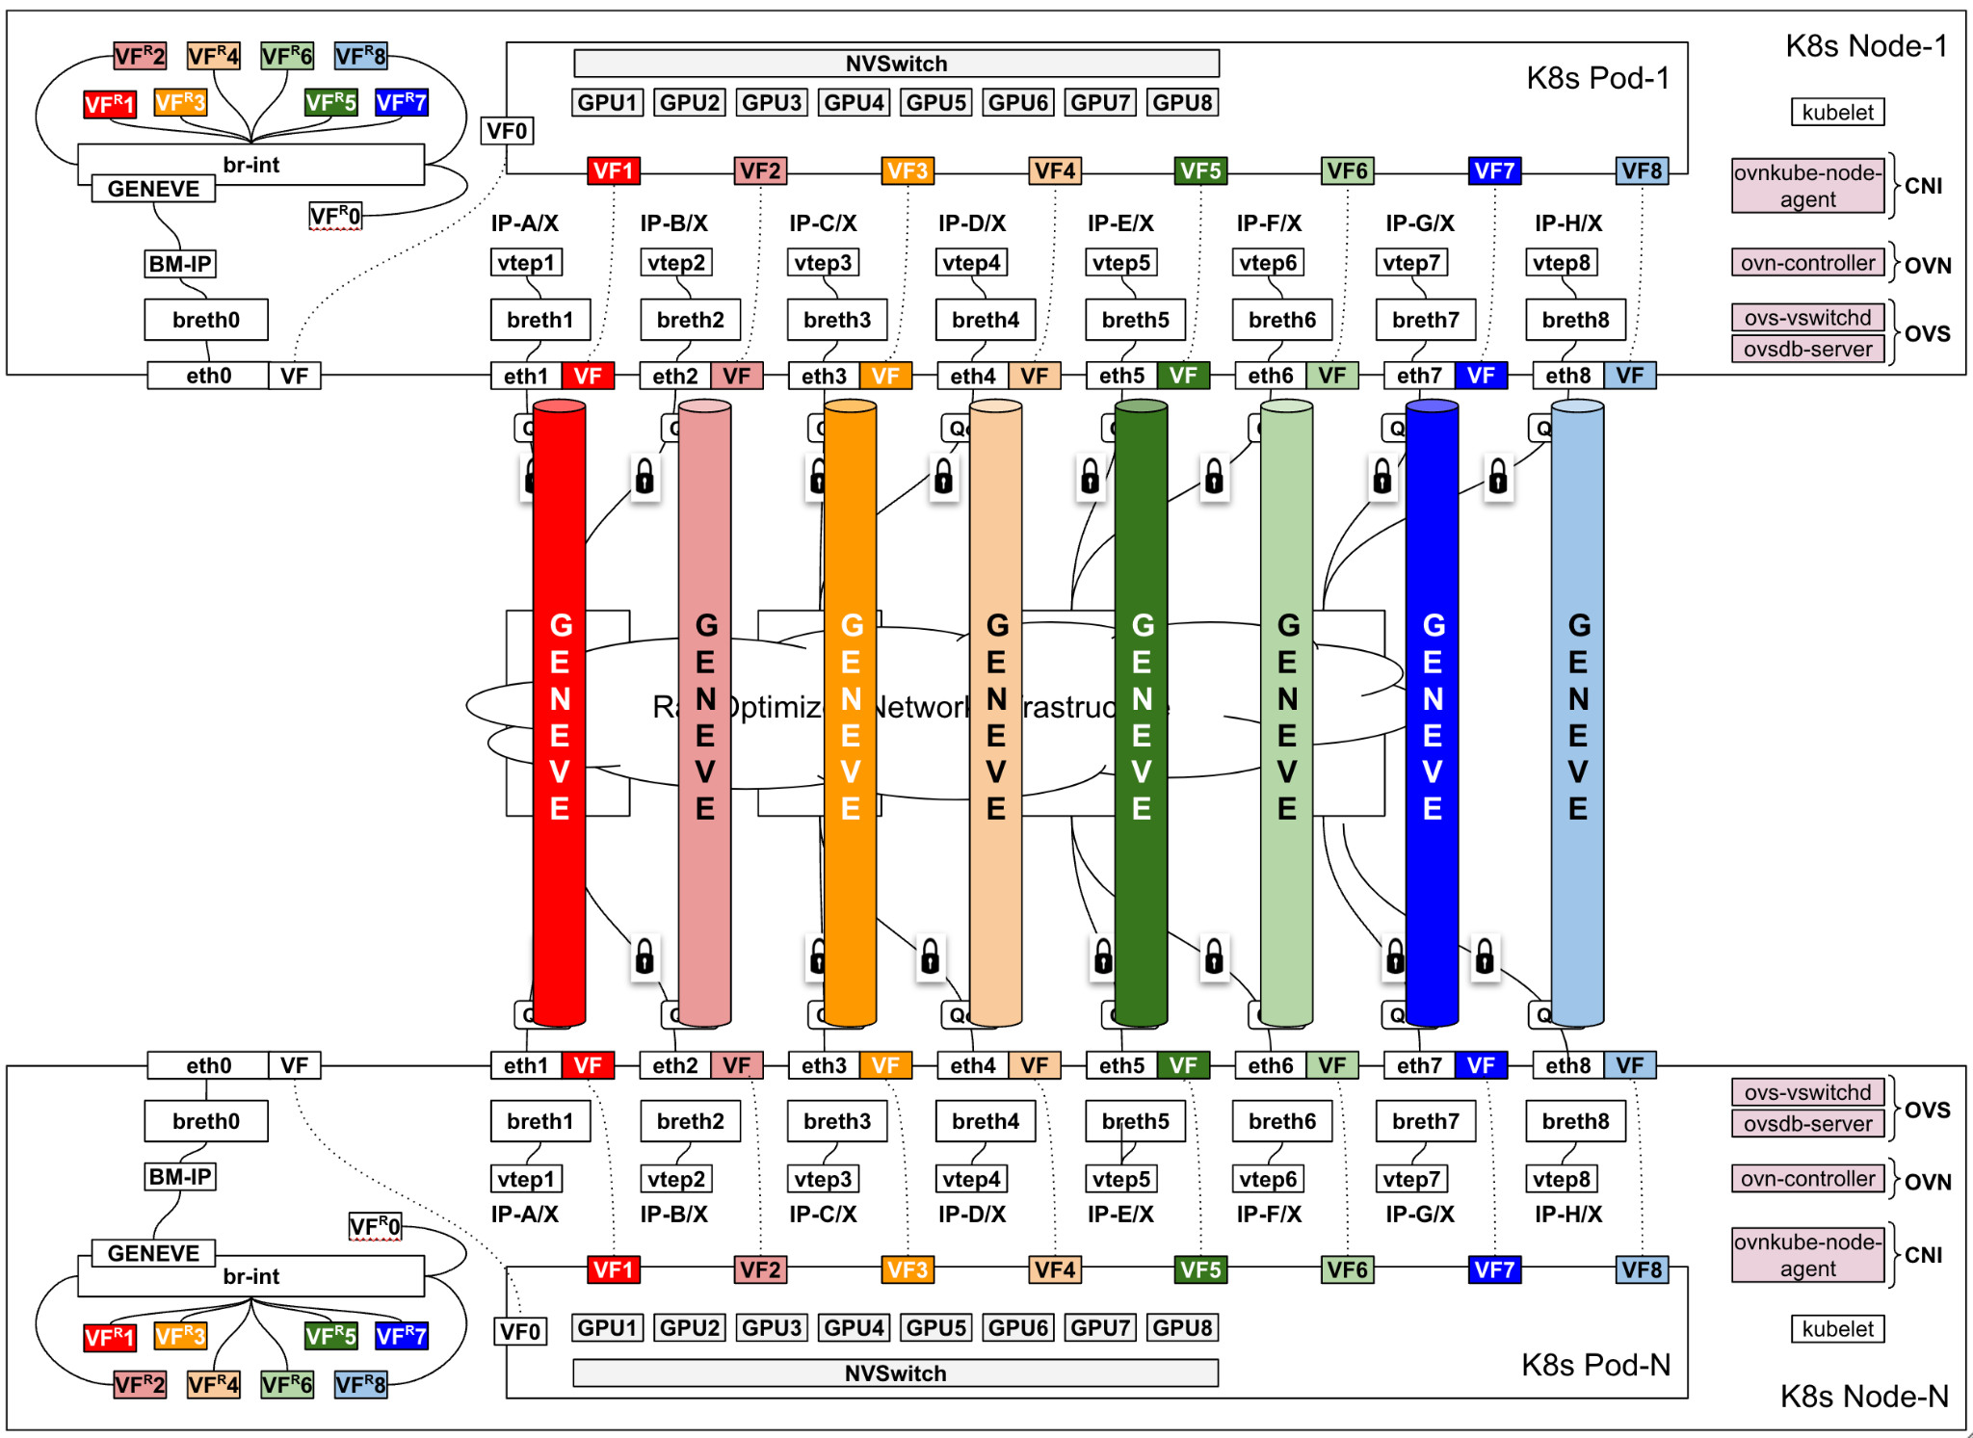
Rail Optimized DC Architecture - SDN Overlays (GENEVE)

Slide 28
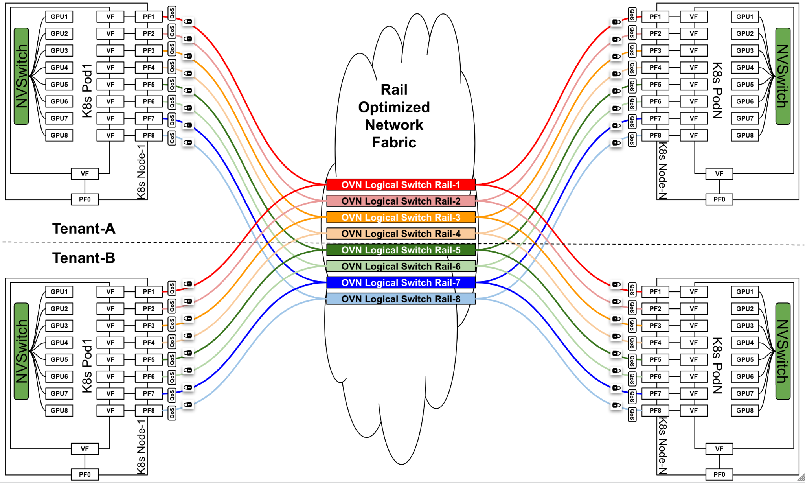
Rail Optimized DC Architecture - Multi-Tenancy

Slide 29
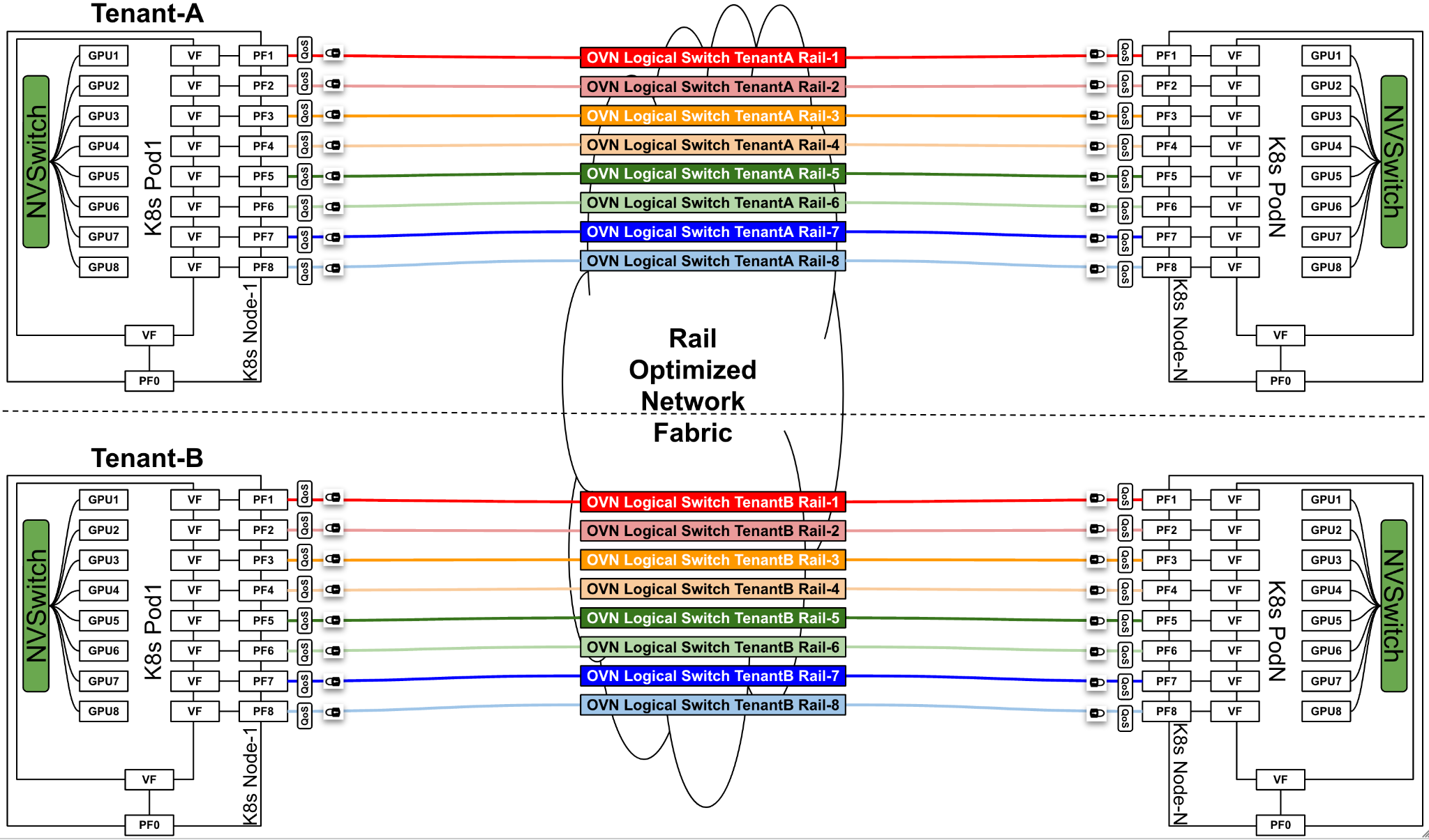
Rail Optimized DC Architecture - Multi-Tenancy

Slide 30
Summary
AI Cloud Networking Infrastructure can be powered by OSS Software
Join us in https://ovn-kubernetes.io/ to advance it!
References
Fast Inter-GPU Communication with NCCL for Deep Learning Training, and More
NCCL: High-Speed Inter-GPU Communication for Large-Scale Training

